Slide 1
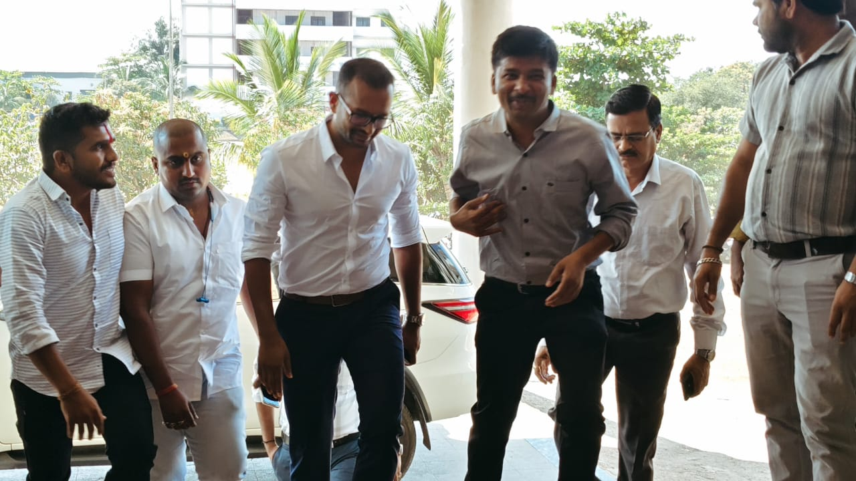
Nootan Homoeopathic Medical College & Hospital , Kavathemahankal , arranged guest lecture on Preparation of MPSC, UPSC & Govt. competitive exam to enhane and nurture students potential. Guest Speaker- Dr. Sachin Mote, Deputy Commisioner/ Director of Income Tax Dept Mumbai. Date : -03/02/2025

Slide 2
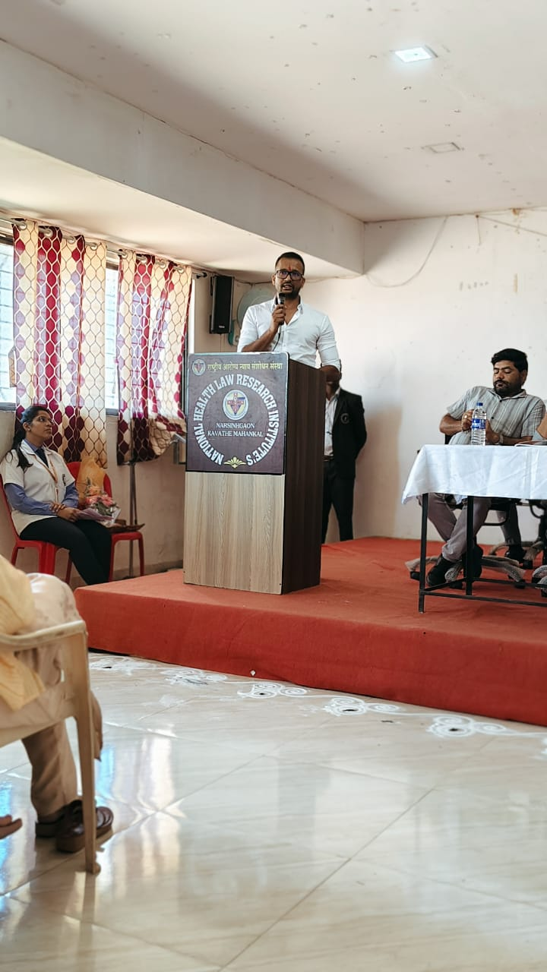
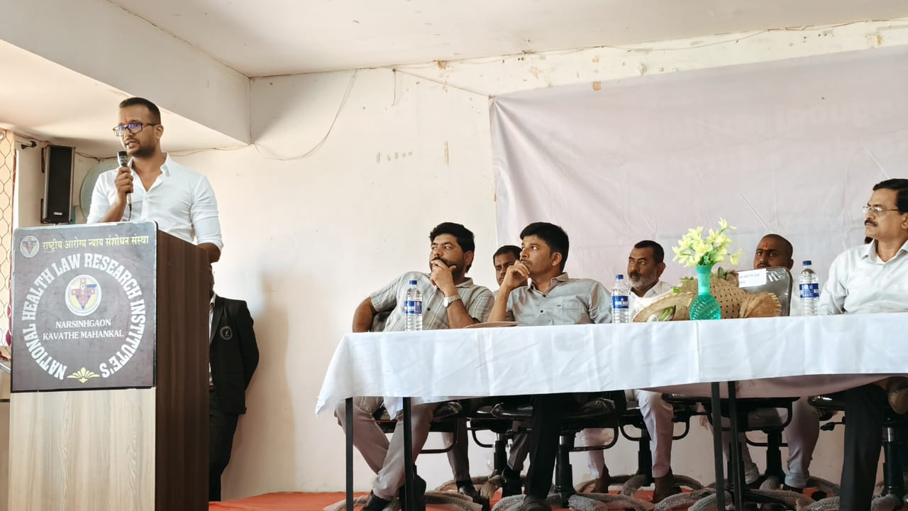

Slide 3
